Slide 1
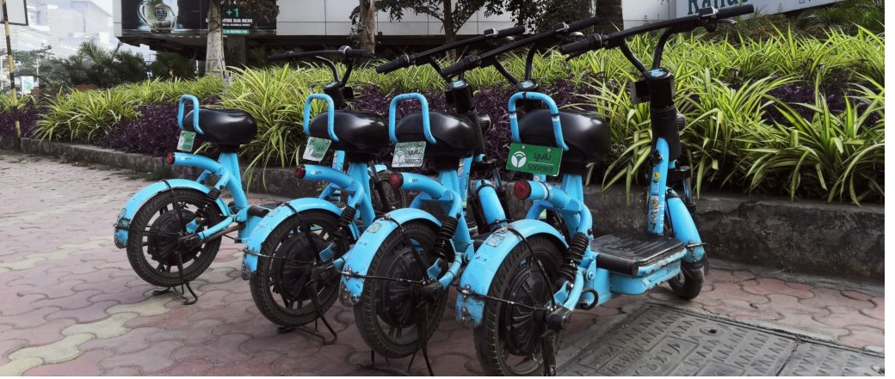
Bike Sharing Data Analysis
Har Shobhit Dayal

Slide 2
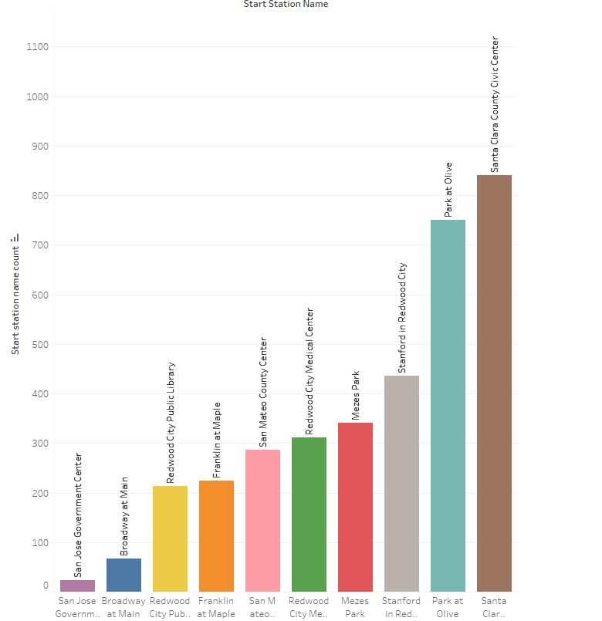
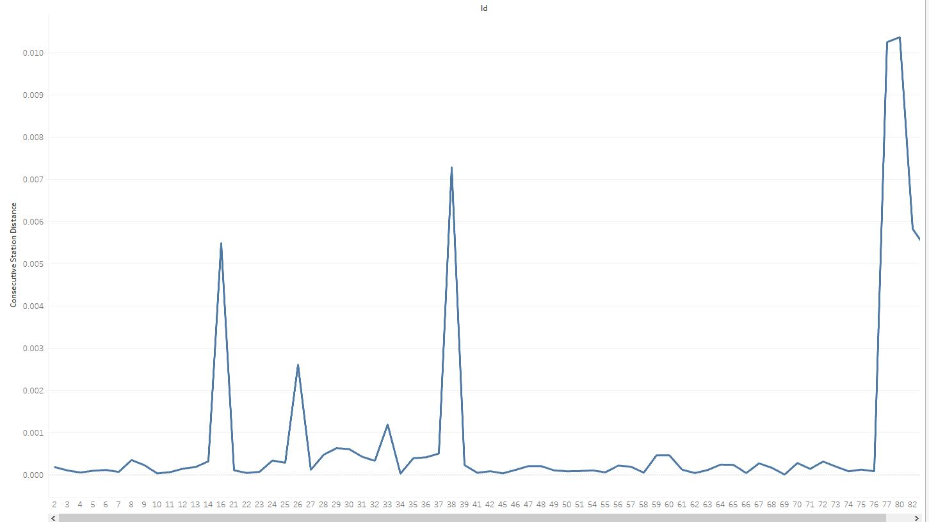
Demand Prediction
Zulip is currently facing some losses and have decided to shut down operations of 3 stations.
In order to decide which stations to shut down 3 factors are of prime importance
Least Popular Stations - Stations which are frequently used by customers.
Idle Time – Time duration in which more than 3 bikes are available at a station.
Consecutive Station Distance – Haversine distance between the consecutive distance.
The below bar chart depicts top 10 least popular stations.
Stations which are not used frequently can be potential targets for shut down.
50 % of least popular stations have less than 300 number of trips on average.
Below line chart depicts about consecutive station distance between the stations.
Shutting down one station close to another would not affect the day to day activities that much.
It can be seen Station Id’s 2 to 14, 21 to 26 and 39 to 76 are quite close to each other
Station ID vs Consecutive Station Distance
Station Name vs Number of Trips for the Station

Slide 3
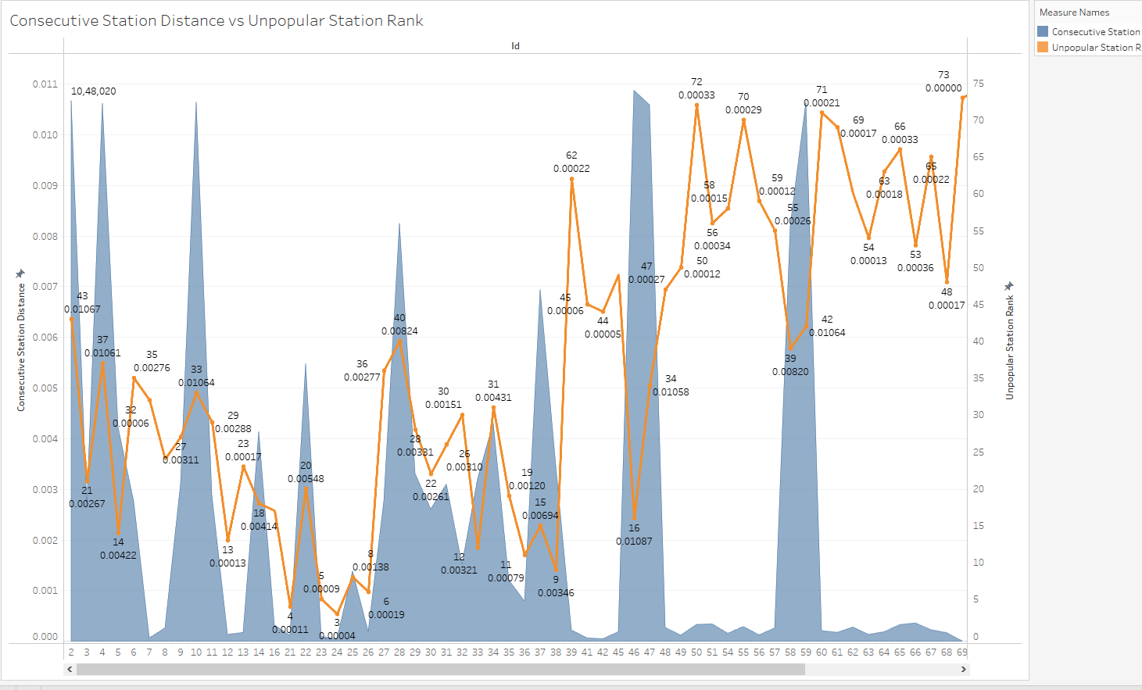
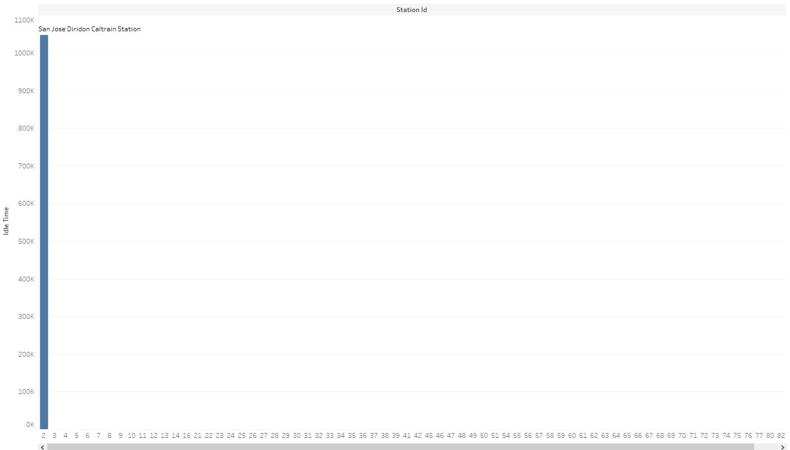
Least popular stations were assigned a unpopular station rank and the data was then merged with station table.
Consecutive station distance of the stations ranked according to unpopular station rank was calculated to decide which stations can be shut down.
In the below chart the blue portion in graph represents the consecutive station distance and the orange line represents the unpopular station rank.
Station 21 ,23 and 24 were found to have high unpopularity rank and were having small values for consecutive station distance which are suitable candidates for shutting down.
Below plot gives an idea about idle time(in seconds) for a given station.
Only station ID 2 was a having an idle time of 1048020 seconds and all the remaining stations were having an idle time of 0.
Station ID vs Unpopular Station Rank, Consecutive Station Distance of Unpopular Stations
Station ID vs Idle Time

Slide 4
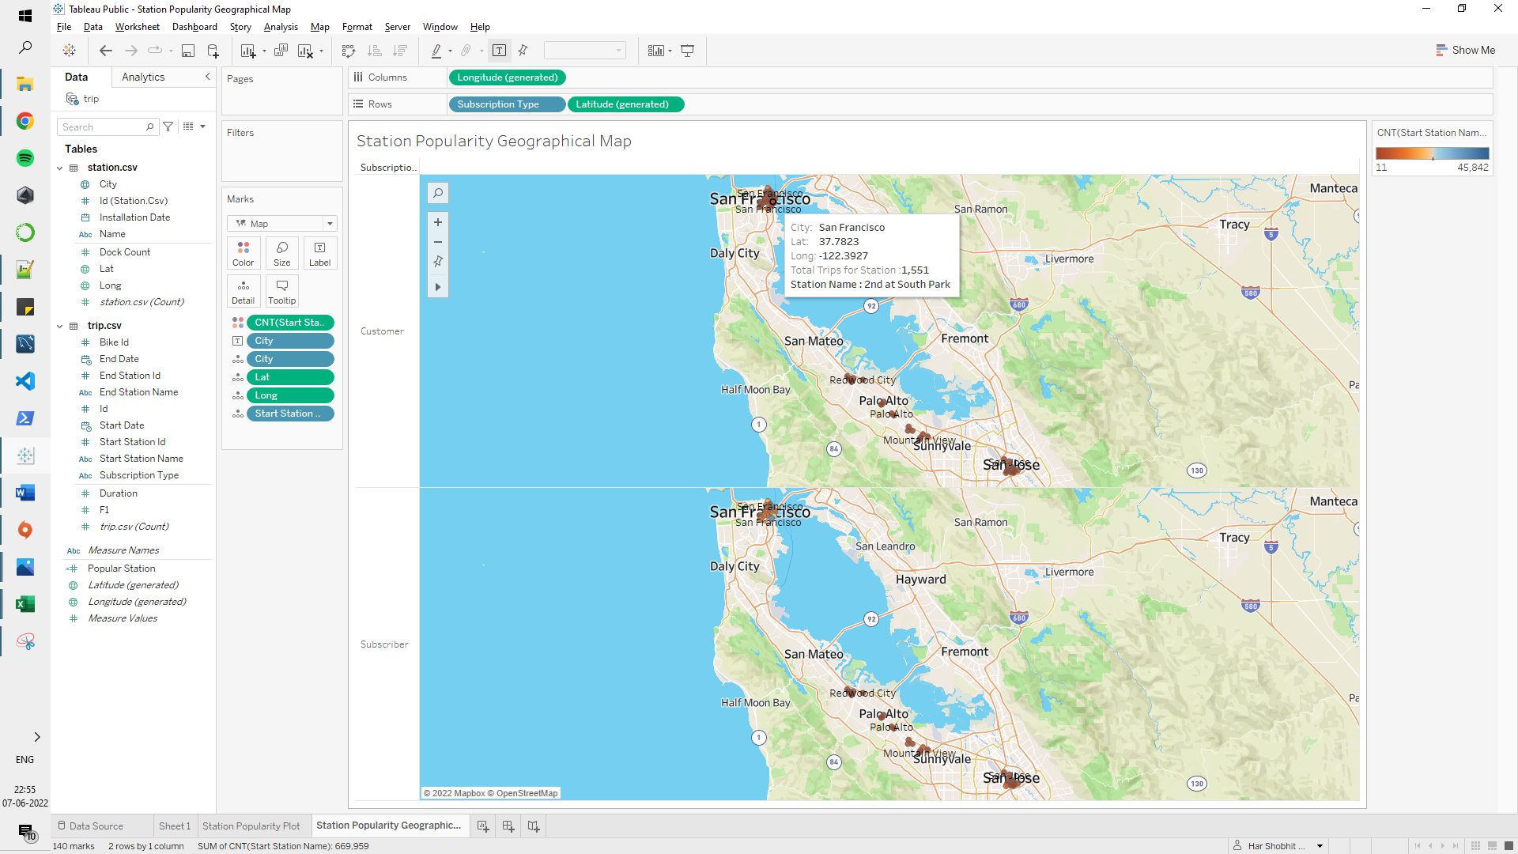
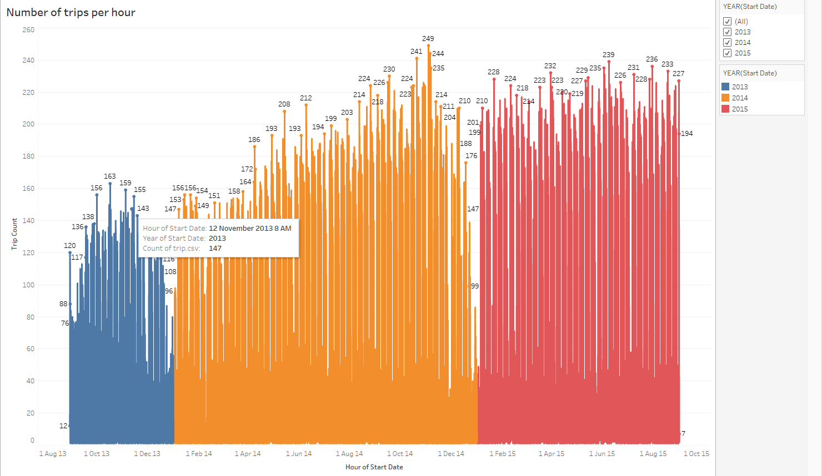
Optimizing Operations
Stations which are more popular are in dark blue color gradient and which are less popular are shown in dark red gradient in below plot.
Bikes can be taken from less popular to more popular stations to meet customer demands
Throughout the day bikes move from one station to other which requires bikes to be rebalanced between stations in order to meet the customer demands.
In order to optimize operations following factors are important
Number of trips per hour and popularity of the stations on the basis of number of trips in past.
Bikes are available at the origin station and sufficient docks are available to drop the bikes.
Average number of bikes and dock count at each station.
Below plot describes about number of trips per hour for a given day.
It was observed that peak time for most stations was between 7-10 am in morning and 3-6 pm in the evening.
Time of day where there is less rush, bikes can be transported from one station to other for rebalancing.
Hour of Start Date vs Trip Count for that Hour
Station Popularity Geographical plot

Slide 5
Couple Bikes
A new product line is being introduced to enable two persons to travel at the same time.
Various factors like convenience, fee and many more were considered to decide if the idea of couple bikes is suitable or not.
Below pie chart talks about the various factors considered and importance of each factor.

